Slide 1
CSP2104 Object-Oriented Programming in C++
Module 5
Performing Loops

Slide 2
On the Agenda…
Learn about the while loop
Write some typical loops
Learn to avoid common pitfalls with loops
Accumulate totals
Learn about the for loop
The range-based for loop (C++ 11)
Learn about pre-test and post-test loops
Nest loops
Use structure fields in loops

Slide 3
The while Loop
Syntax:
while (Boolean expression)
{ action while expression is true; }
#include <iostream>
using namespace std;
int main() {
const int NUM_LOOPS = 5;
int count = 0;
while (count < NUM_LOOPS) {
cout << “Hello!” << endl;
++count;
}
system(“pause”);
return 0;
}

Slide 4
Typical Loop Usage
Loops are commonly used for
Input verification
Reading input records
Two examples where the output is not ‘quite’ right.
cin >> userResponse;
if (userResponse == ‘T’)
cout << “You responded True” << endl;
else
cout << “You responded False” << endl;
cin >> userResponse;
if (userResponse != ‘T’ && userResponse != ‘F’) {
cout << “Invalid response.” << endl;
cin >> userResponse;
}
if (userResponse == ‘T’)
cout << “You responded True” << endl;
else
cout << “You responded False” << endl;

Slide 5
Typical Loop Usage
Solution, place the input verification in a loop until they give the correct response
cin >> userResponse;
while (userResponse != ‘T’ && userResponse != ‘F’) {
cout << “Invalid response.” << endl;
cin >> userResponse;
}
if (userResponse == ‘T’)
cout << “You responded True” << endl;
else
cout << “You responded False” << endl;

Slide 6
Typical Loop Usage
Reading through input records
#include <iostream>
using namespace std;
int main() {
int itemNumber;
double price;
double discountAmount;
double newPrice;
const double RATE = 0.20;
cout << “Enter the item number or 0 to quit: “;
cin >> itemNumber;
while (itemNumber != 0) {
cout << “Enter price for item #” << itemNumber << “ “;
cin >> price;
discountAmount = price * RATE;
newPrice = price – discountAmount;
cout << “Item #” << itemNumber << “ was $” << price << endl;
cout << “but with a discount of $” << discountAmount <<
“, it is $” << newPrice << endl;
cout << “Enter another item number or 0 to quit: “;
cin >> itemNumber;
}
system(“pause”);
return 0;
}
Initial read to start
the loop.

Slide 7
Accumulating Totals
Through each iteration, the total is calculated as the current value plus the new purchase cost.
#include <iostream>
using namespace std;
int main() {
const int QUIT = 0;
double purchase, total = 0;
cout << “Enter amount of first purchase $”;
cin >> purchase;
while (purchase != QUIT) {
total += purchase;
cout << endl << “Enter amount of next purchase or “ <<
QUIT << “ to quit”;
cin >> purchase;
}
cout << endl << “Your total is $” << total;
system(“pause”);
return 0;
}

Slide 8
Common Pitfalls to Avoid
Adding an unwanted semicolon
Can lead to an empty loop body and an infinite loop
Use Ctrl + C or Ctrl + Break to stop the loop
Forgetting curly braces
Failing to initialize a loop control variable
Failing to alter a loop control variable
Making the same mistakes as with selections

Slide 9
Unwanted Semicolon
Careful!
int number = 1;
while (number <= 10);
{
cout << number << endl;
++number;
}

Slide 10
Forgetting Curly Braces or to Alter a Loop Control Variable
Careful!
int number = 1;
while (number <= 10)
cout << number << endl;
++number;

Slide 11
Failing to Initialise a Loop Control Variable
#include <iostream>
using namespace std;
int main() {
int number;
while (number <= 10) {
cout << number << endl;
++number;
}
system(“pause”);
return 0;
}

Slide 12
The for Loop
Syntax
for (initialize; evaluate; alter)
{ statement that executes when evaluation is true; }
int count;
count = 1;
while (count < 4) {
cout << count << “ “;
++count;
}
int count;
for (count = 1; count < 4; ++count)
cout << count << “ “;

Slide 13
Searching and Substrings Example
#include <iostream>
#include <string>
using namespace std;
int main() {
string input, stringPattern = “hello”;
int stringAppearances = 0;
cout << “Type some text which will be searched for to see how many
times you can say: “ << stringPattern << endl;
getline(cin, input, ‘\n’);
for (int i = input.find(stringPattern, 0); i != string::npos;
i = input.find(stringPattern, i)) {
stringAppearances++;
i++;
}
cout << “Your string: “ << stringPattern << “, appeared “ <<
stringAppearances << “ times.” << endl;
system(“pause”);
return 0;
}
Notes:
This code will prompt the user to type in some text.
It will then search for the phrase “hello” until it reaches the end of the string input by the user (identified by npos)
It will then output their string and how many times they typed hello.

Slide 14
Looping Through Arrays
Loops are very useful when working with arrays.
#include <iostream>
using namespace std;
int main() {
const int NUM_PRICES = 10;
double price[NUM_PRICES];
int sub;
for (sub = 0; sub < NUM_PRICES; ++sub) {
cout << “Enter a price: $”;
cin >> price[sub];
}
cout << endl << “The enter prices, in reverse order:” << endl;
for (sub = NUM_PRICES – 1; sub >= 0; --sub)
cout << price[sub]; << “ “;
cout << endl;
system(“pause”);
return 0;
}

Slide 15
Using Part of an Array
When you want to access a single array element use a subscript ([X]) that indicates the position of the value you want to access
When you want to access all of the elements in an array, a for loop is often most convenient
You may also want to access several array elements but not necessarily all of them, in this case, a while loop is most convenient

Slide 16
The Range-Based For
You will often need to loop through arrays (or other collections) of things having to access each element once.
C++ 2011 added the Range-Based For loop to make this simpler.
Syntax:
for (for-range-declaration: expression)

Slide 17
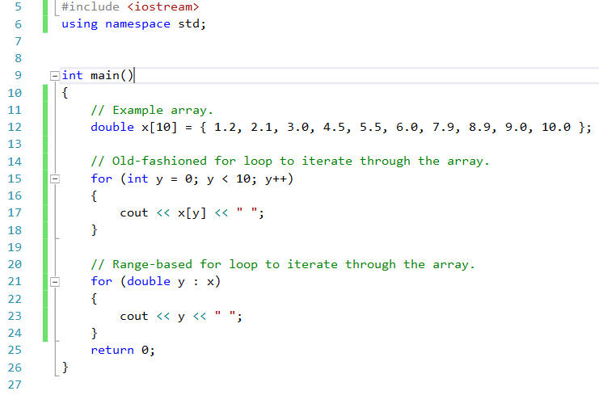
The Range-Based For
Example:

Slide 18
Loops
Count-controlled loop
Execution is controlled by counting the number of repetitions
You can declare a loop variable
for (int count = 1; count < 4; ++count)
cout << count << endl;
Pre-test vs Post-test
Pre-test loop: The control variable is tested before the loop body
for
while
Post-test loop: The control variable is tested after the loop body
do-while, syntax:
do statement;
while (Boolean expression);

Slide 19
Pre-test vs Post-test Loops
int count = 1;
while (count < 1) {
cout << count << endl;
++count;
}
int count = 1;
do {
cout << count << endl;
++count;
} while (count < 1);
Notes:
The while loop will not execute at all as count == 1 not < 1.
The doo loop will execute once and then check.

Slide 20
Nested Loops
A loop inside a loop
Outer loop which contains another
Inner loop contained inside the outer loop
Within each pass through an outer loop the inner loop executes to completion
#include <iostream>
using namespace std;
int main() {
double startInv = 3000.00;
double stopInv = 9000.00;
double stepInv= 1000.00;
double startPct= 0.04;
double stopPct= 0.08;
double stepPct= 0.01;
double amt, pct;
for (amt = startInv; amt <= stopInv; amt += stepInv) {
cout << “$” << amt << “ “;
for (pct = startPct; pct <= stopPct; pct += stepPct) {
cout << amt * pct << “ “;
cout << endl;
}
system(“pause”);
return 0;
}

Slide 21


